Slide 1

MadNet
Fast, secure, offline file transfer, redefine the way you share large files!

Slide 2

The Internet has become an integral part of our lives.
It has revolutionized communication, information access, and collaboration.

Slide 3

Scenario -1
Picture a world without the Internet:
No ChatGPT, Bard, or any other large language models.
No access to YouTube, Coursera, or any other learning platforms.
No presence on social media platforms, and so on.

Slide 4
Current Scenario

Slide 5
Scenario -2
Envision yourself at an airport, waiting for your flight, and unable to stream a movie during the journey.
As a media house owner, consider the possibility of reducing server load on your infrastructure. Offer content to users for free and potentially increase subscription charges.

Slide 6

Introducing the MadNet Server Mechanism
Experience super-fast speeds for transferring larger files without the need for the Internet.

Slide 7
Media houses can benefit from the MN Server mechanism to reduce server loads.
Efficient file transfers ensure timely broadcasting and content distribution, even in high-demand areas like airports.

Slide 8
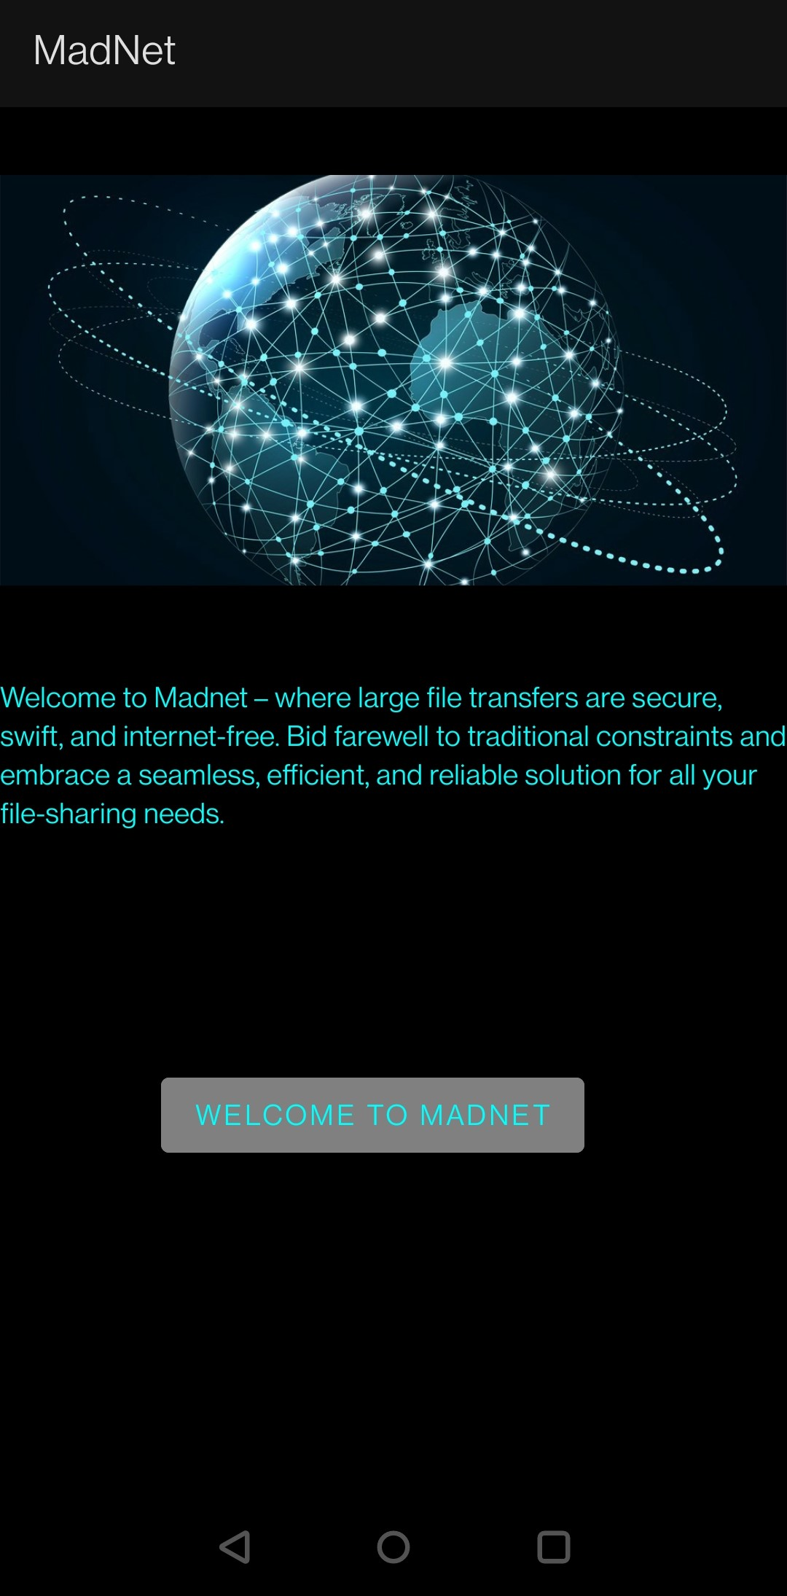
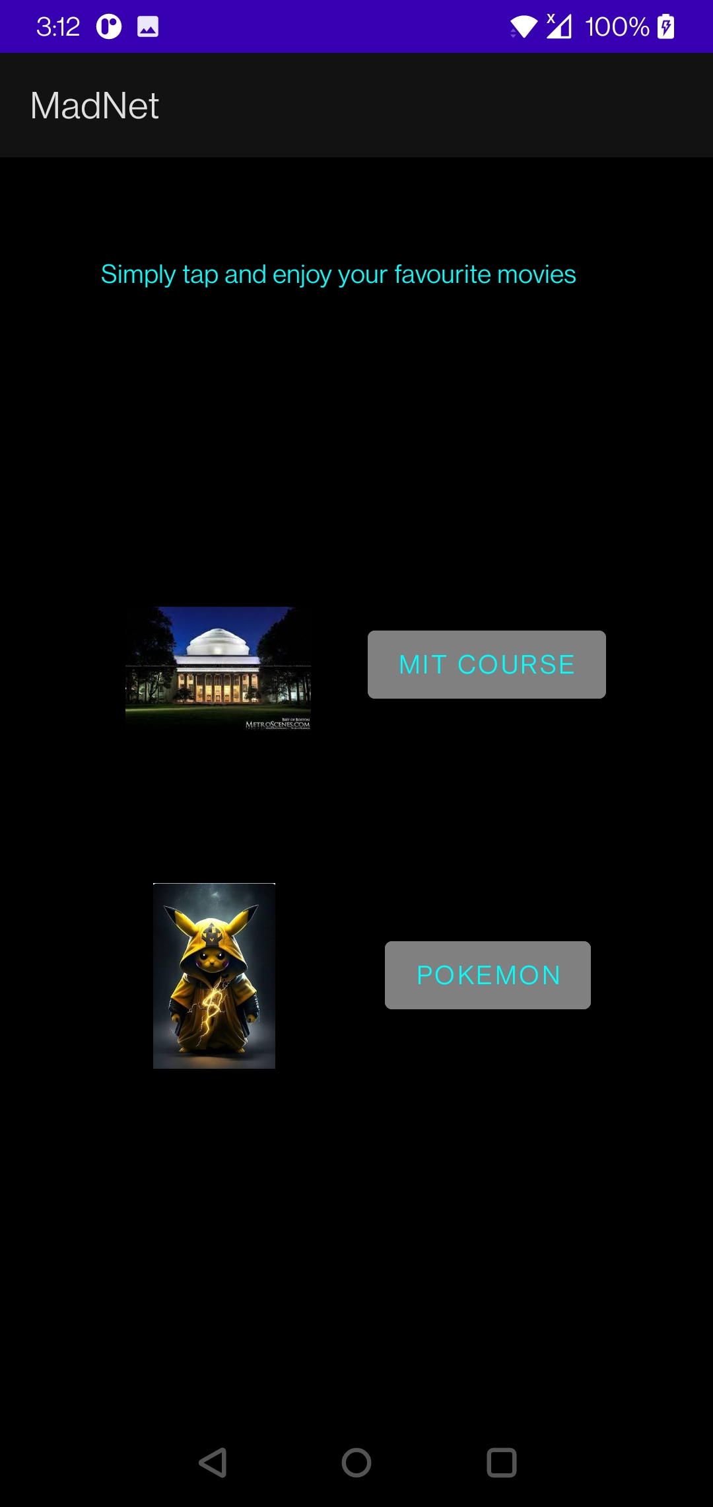

MadNet App
Secure Transfers
Swift Performance
Internet-Free Convenience
User-Friendly Interface
Efficient Server Mechanism

Slide 9

MadNet Server Architecture
This server architecture is designed to efficiently handle video file requests, providing a modular and scalable structure for serving files to clients. It leverages the capabilities of Node.js and Express.js while integrating external modules for additional functionalities.
Chunking is a technique used to divide large media files, such as videos, into smaller segments or "chunks." Each chunk represents a portion of the original file and is typically of a fixed size

Slide 10

Encryption of the chunks
The script then reads the input file (${name}.mp4), encrypts it using the cipher, and writes the encrypted data to an output file (enc_${name}.mp4). The process is performed in chunks, enhancing efficiency and enabling resumable downloads. This approach provides a secure and swift mechanism for encrypting large media files, suitable for scenarios where confidentiality and speed are paramount. The encrypted file is then ready for secure transmission or storage.

Slide 11
Different Mechanism vs Speed

Slide 12

Thank You!

